Slide 1
ModusToolbox Software 2.0 An Overview and Introduction
Dheeraj Kamath - Applications Engineer
WW 20 12

Slide 2
Agenda
Introduction
Core Tools
What they are and where to get them
The make infrastructure and how it works (high level)
How you create a project
Software Enablement
BSPs, HALs, PDLs and other libraries
Supported Ecosystems

Slide 3
Introduction

Slide 4
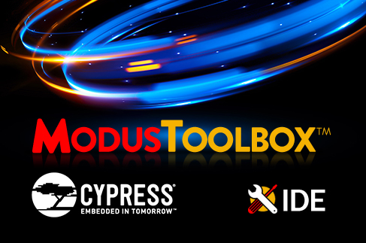
What is ModusToolbox Software?
It is a collection of tools and libraries
It is compatible across environments (Linux, macOS, Windows)
What does it include?
Configuration tools
Low-level drivers
Middleware libraries
Operating system support
ModusToolbox IDE

Slide 5
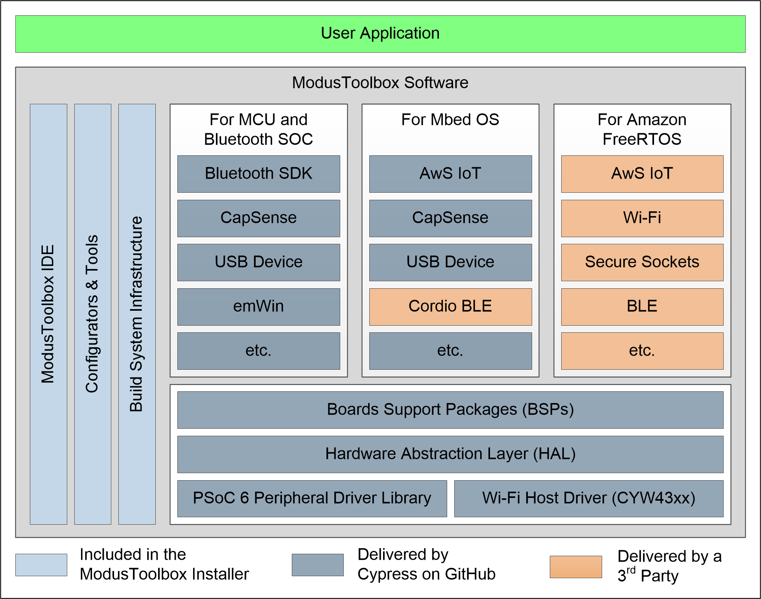
Design Goals
Comprehensive
it has the resources you need
Flexible
you can use the resource in your own workflow
Atomic
you can get just the resources you want

Slide 6
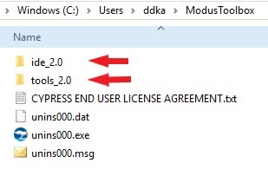
What is in the MTB Installer?
Build system infrastructure
Configurators and tools
ModusToolbox IDE
Note: Installer does not include enablement software such as
driver libraries or middleware

Slide 7
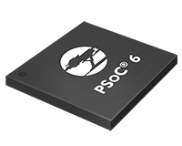


Where is the SDK?
It is on GitHub as a collection of independent repositories
https://github.com/cypresssemiconductorco/
It also provides libraries to be used in particular ecosystems
MCU and Bluetooth SOC ecosystem – PSoC6, Wi-Fi, Bluetooth and BLE
Mbed OS ecosystem – Mbed OS, TLS, Cloud Services
Amazon FreeRTOS ecosystem – FreeRTOS kernel, AWS libraries, AWS Cloud Services

Slide 8
Core Tools

Slide 9
Core Tools
Build Infrastructure
Configurators and tools
Utilities
ModusToolbox IDE

Slide 10
Build Infrastructure
What does it do?
creates a project
either a folder that contains all the files, or a ModusToolbox IDE project
creates an executable
provides debug capabilities
A makefile defines everything required for your project, including:
the target hardware (board/board support package to use)
the libraries to use for the project
the build tools to use
compiler/assembler/linker flags to control the build
In MTB 1.1 a similar concept in a file called modus.mk – that is gone
New makefile is called, get this, makefile ☺

Slide 11
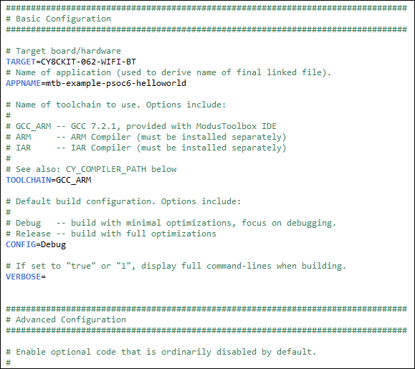
Build Infrastructure
You set values for variables in the makefile
You invoke the makefile
Three ways
From the command line
Use a new tool called Project Creator
just does that, doesn’t compile or build
Use the ModusToolbox IDE
Managing the makefile is documented in KBA229177

Slide 12
Create a Project
In MTB IDE – you get an actual Eclipse-based project
Use the New Application wizard
No device selection, it is boards only
Project Creator
It is the “New Application” wizard without the IDE
You get a project folder with all the files
Command Line
make getlibs (covered in upcoming slides)
You get a project folder with all the files
Behind the scenes – all three approaches invoke make getlibs
That’s what does the real work
On the command line it’s explicit, otherwise implicit/hidden

Slide 13
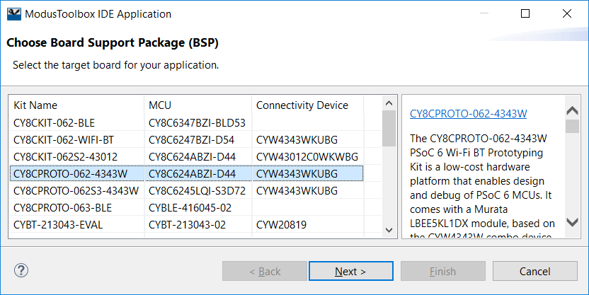
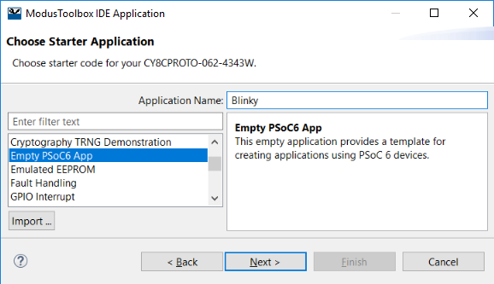
Create a Project (using ModusToolbox IDE)

Slide 14
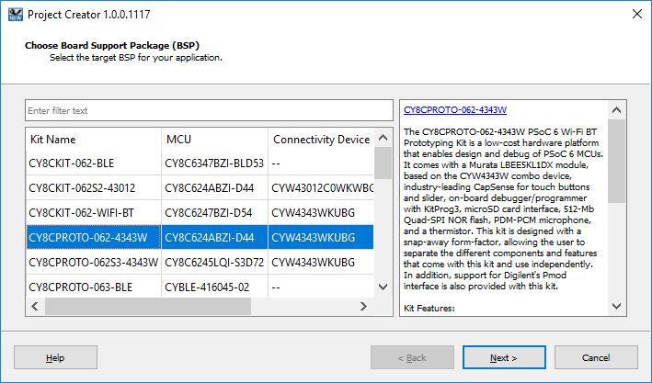
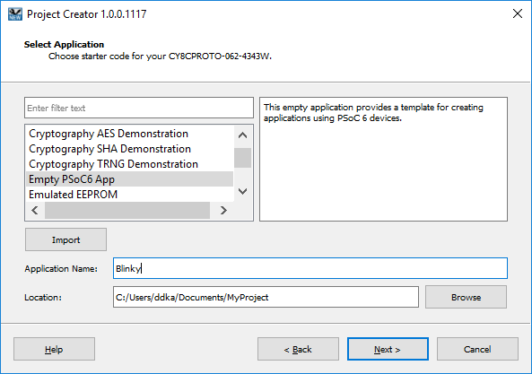
Create a Project (using Project Creator)
Tool available under: “ModusToolbox\tools_2.0\project-creator”

Slide 15
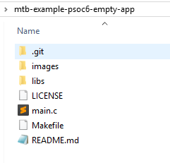
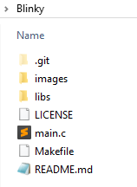
Autodiscover and Project Creation
When creating a project, it starts in the folder containing the makefile
It creates a new folder (based on project name) and copies all required resources into the project folder
Template project
(fetched from Github / imported from local copy)
Your project
(created in your workspace directory)

Slide 16
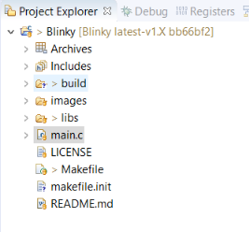
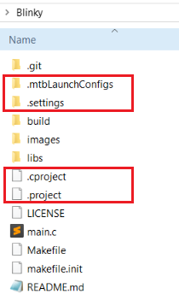
Autodiscover and Project Creation
All files appear in a project folder
Using Project Creator, wherever you specify
Using the IDE, in the Eclipse workspace
If you use the IDE, you also get a project file

Slide 17
Autodiscover and Project Creation
Build system automatically discovers all .c, .h, .cpp, .s, .a, .o files in the makefile tree
They are replicated in the project folder
You can add files that reside outside the makefile folder
add another directory using the CY_SHAREDLIB_PATH variable
You can explicitly list files in the SOURCES and INCLUDES make variables
Example:
INCLUDES=../MySource1 ../MySource2
SOURCES=$(wildcard ../MySource1/*.c) $(wildcard ../MySource2/*.c)

Slide 18
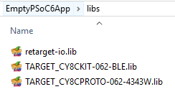
Libraries, .lib Files, and make getlibs
Add a library (e.g. middleware) by using a .lib file
You create a .lib file for each library you want to use – this is what’s in the file
https://github.com/cypresssemiconductorco/emwin/#release-v5.48.1
The last part of the URL is a git tag that specifies a particular commit I want to use
A release tag never moves, so you can point your app to a stable, known-good release
Instead of a tag, you can use an actual commit hash
make getlibs
Finds each .lib file
Reads it
Clones the repository
Checks out the code for the specific commit
Adds those files to the libs folder in the new project folder

Slide 19
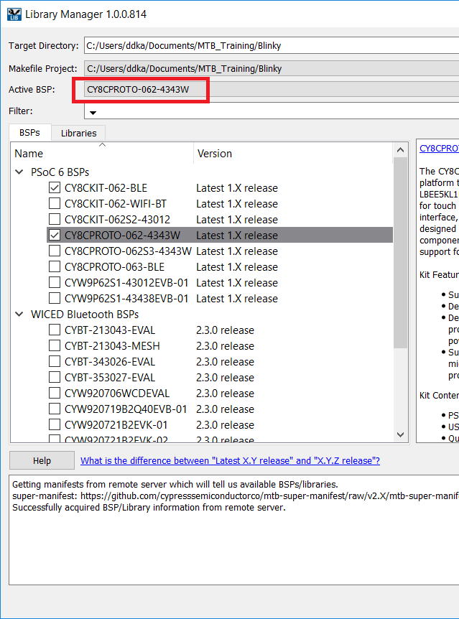
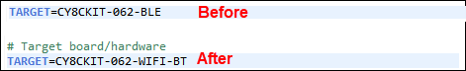
Library Manager
Stand alone tool or inside the IDE
Add, remove, change version of any library
You can pick a BSP!
To retarget an application to a new kit
Open the Library manager
Pick the new kit
The new kit must support the same features/functionality but…
All BSPs use a consistent set of definitions
Library manager updates the makefile

Slide 20
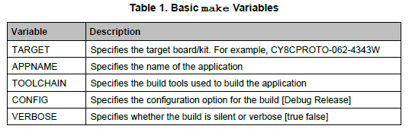
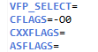
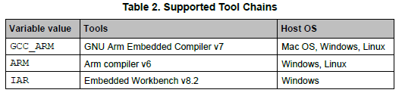
Create an Executable
Build infrastructure provides several variables you use to control the build
MTB Installs GNU Arm toolchain, that’s the default

Slide 21
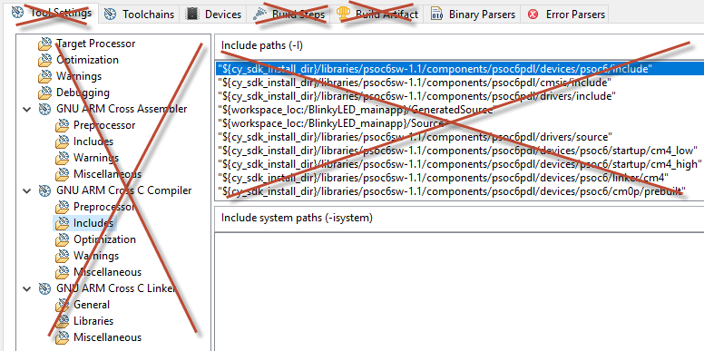
Building Code from Within the IDE
A build command in the IDE wraps around make build from the command line
The “standard” Eclipse compiler build settings are all gone
To change build settings, you edit the makefile. Build behaves precisely the same regardless of environment

Slide 22
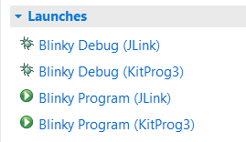
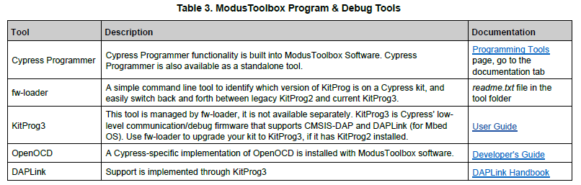
Program and Debug
the application creation process generates launch configurations

Slide 23
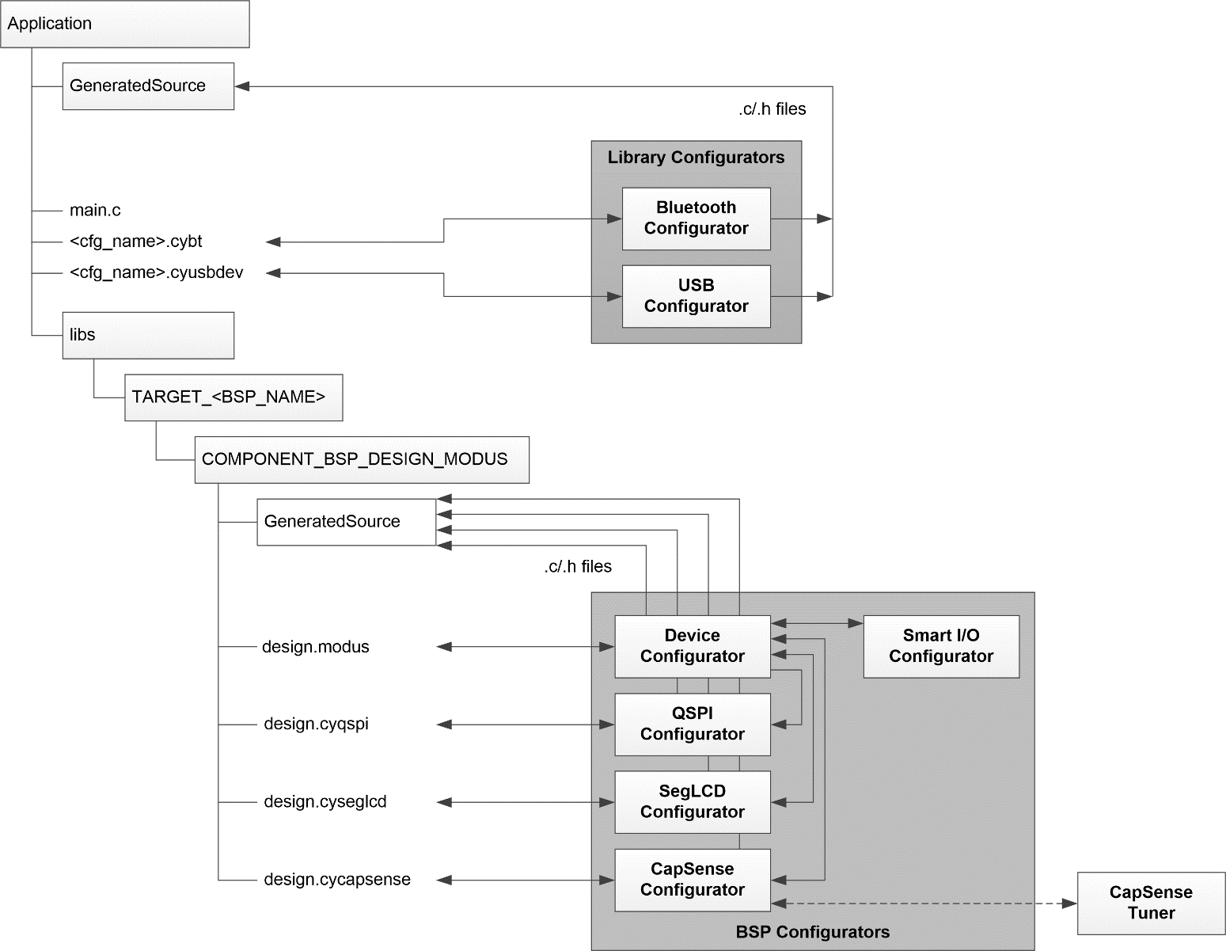
Configurators and Tools
Introduces the concept of BSP Configurator and Library Configurator
Some changes in storing data
It is not all in the design.modus file
There are two GeneratedSource folders in different places

Slide 24
New Configurators and Tools
Configurator or Tool | Description
seglcd-configurator | Configure a generic LCD Direct Segment Drive controller for a variety of LCD glass at different voltage levels with multiplex ratios up to 16x.
project-creator | Create a new application project. This tool is a stand-alone version of the IDE wizard, available as a GUI and a command-line tool (CLI).
cype-tool | The power estimator tool provides an estimate of the power consumed by a target device.
library-manager | Select which library (including BSPs) and which version of each you want to include. Updates the makefile based on your choices.

Slide 25
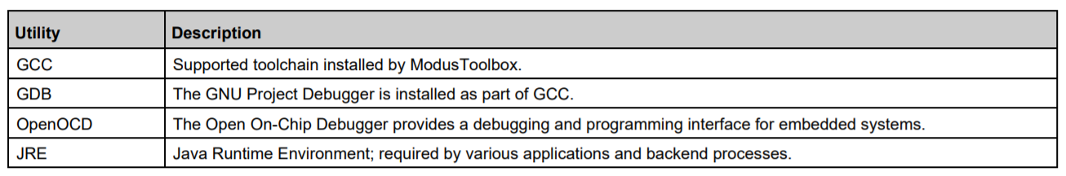
Utilities
Commonly used utilities that are required for application development

Slide 26
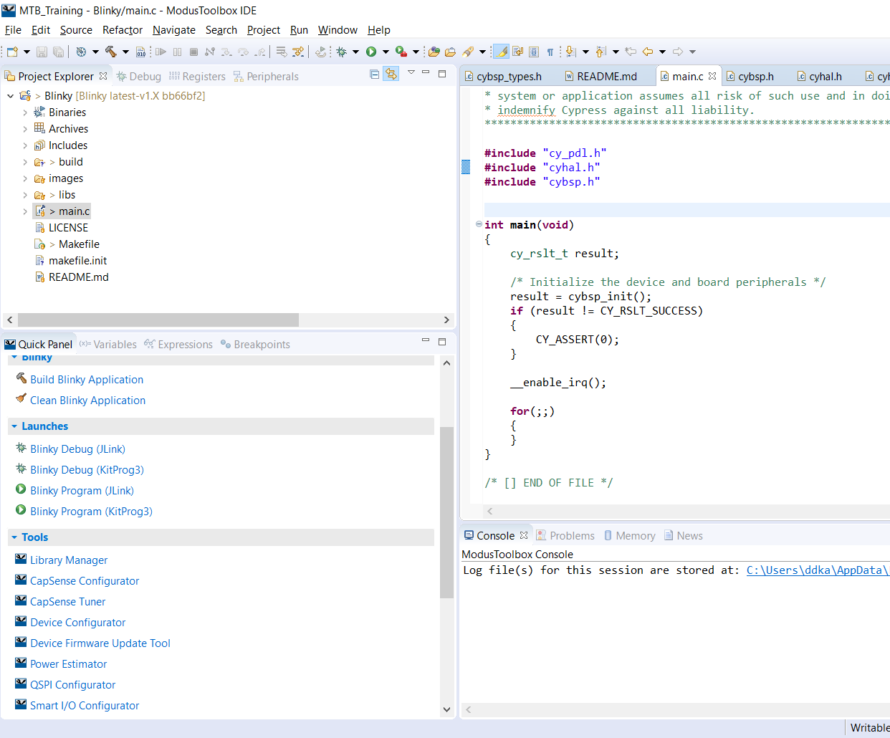
ModusToolbox IDE
100% Optional
The command line infrastructure behind this makes that so
For the IDE, the make infrastructure also creates debug configurations

Slide 27
Software Enablement

Slide 28
What Have We Got?
Aimed at three key ecosystems
PSoC 6 MCU and Bluetooth SoC ecosystem development
Mbed OS ecosystem development
Amazon FreeRTOS ecosystem development
These broad categories
Low-level resources
Middleware
BSPs
Code examples

Slide 29
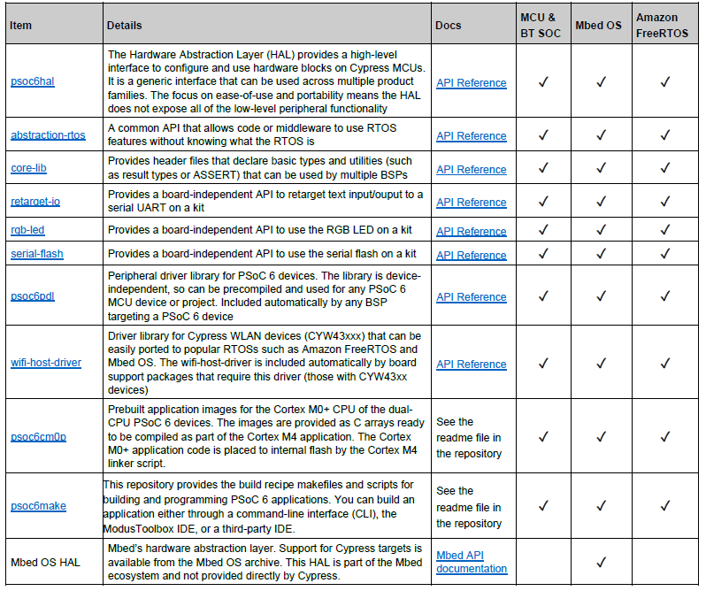
Low-level Resources

Slide 30
Peripheral Driver Library (PDL)
Low level library for interacting with hardware
Simplifies software development
Extensive set of peripherals available
Hardware Abstraction Layer (HAL)
Simplifies access to the low level drivers
One call will work for drivers other than the PDL
Does not do everything the PDL can do
Takes care of resource allocation

Slide 31
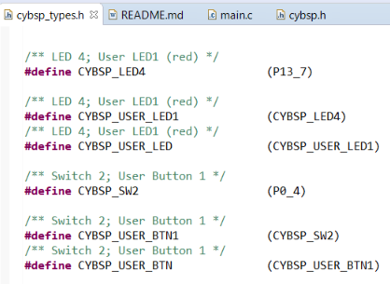
Board Support Package (BSP)
Common language for commonly used peripherals
BSP = a board/kit
You can make your own and be discoverable
Includes any low-level resources (e.g. the PDL library for a PSoC 6 kit)
Has common macros for board peripherals (e.g. the RGB LED)
Typically includes the design.modus file (sets up a default configuration for the kit)
Uses the HAL to configure the board

Slide 32
HAL, BSP and PDL, what do you use?
BSPs use the HAL to configure boards
HAL is intended to be the future
Makes the application device agnostic.
PDL and HAL are 100% compatible – you can mix and match
But it’s possible to use both to configure the same thing (developer’s responsibility)
Intent is that configurator will flag which peripherals it uses
So HAL won’t step on configuration code

Slide 33
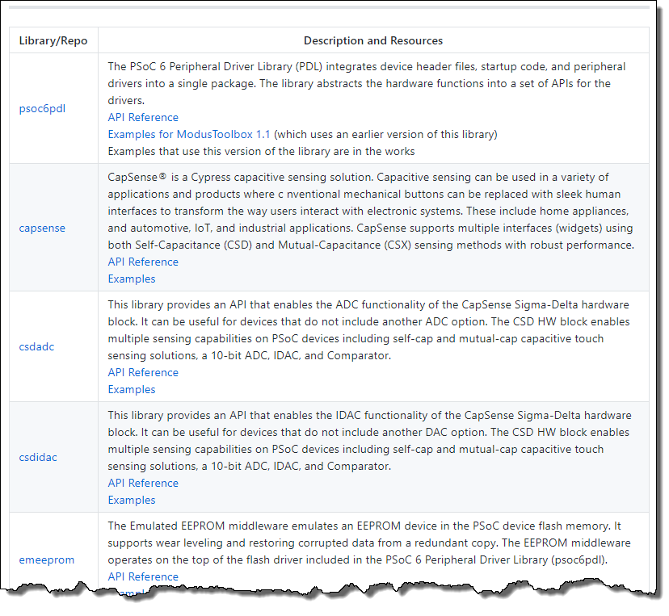
Middleware
Each Cypress library is available independently on GitHub
Some ecosystem libraries just live in that ecosystem
Connectivity middleware
BT SDK (WICED), AWS IoT, Wi-Fi, BLE
PSoC 6 middleware
CapSense, USB Dev, Device firmware upgrade, etc.
Bottom line, there is a LOT
Some work for multiple ecosystems
Some are specific to a particular ecosystem
GitHub landing page for PSoC 6 Middleware

Slide 34
Code Examples
Item | Details
All ModusToolbox Examples | A GitHub landing page with information about the examples and links to various collections.
Bluetooth SDK Examples | A single repository that contains all the BT SDK examples.
PSoC 6 MCU Examples | This search link displays a list of all MCU related examples.
AWS IoT Greengrass Examples | These repositories contain all the AwS IoT-related examples in the Mbed OS ecosystem.
AWS IoT Client Examples
Mbed OS Examples | This search link displays a list of all Mbed-OS examples on the Cypress GitHub site.
All on GitHub!
In general, each example will live in its own repository
exception for an example with multiple projects

Slide 35
Targeted Ecosystems

Slide 36
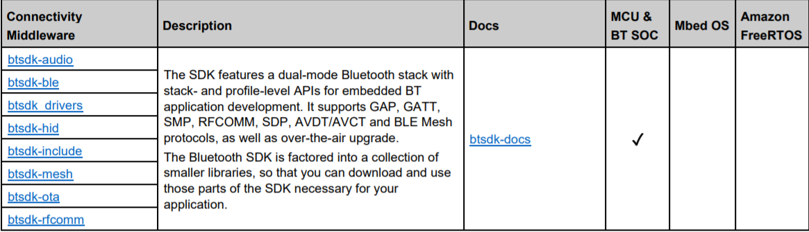
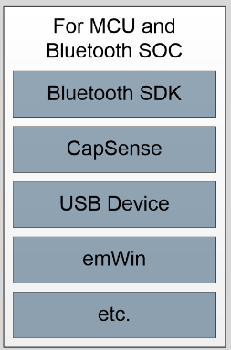
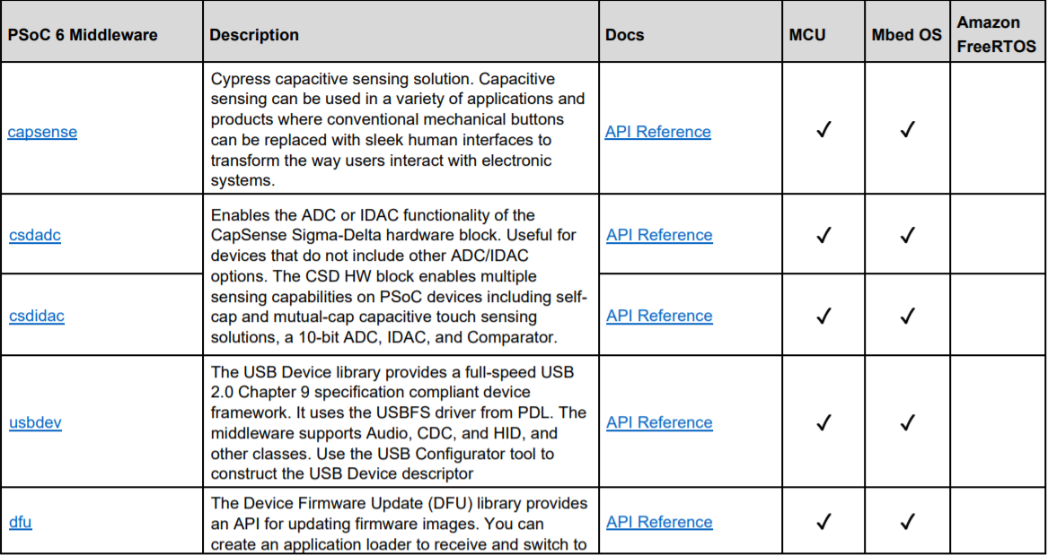
PSoC 6 MCU and Bluetooth SOC Ecosystem
All low-level resources
Most if not all BSPs

Slide 37
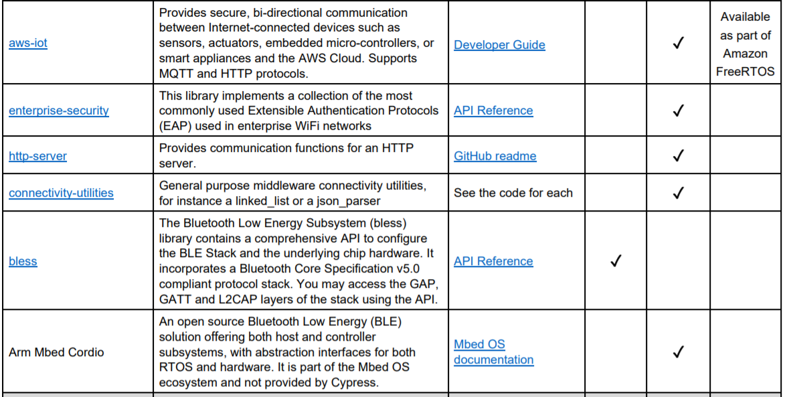
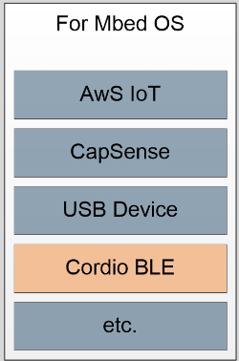
Mbed OS Ecosystem
All low-level resources
BSPs for Mbed supported boards
All PSoC 6 middleware
CapSense, etc.
Support for AWS IoT inside Mbed

Slide 38
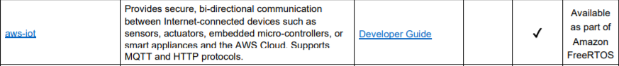
Amazon FreeRTOS Ecosystem
All low level resources
Two BSPs Qualified
CY8CPROTO-062-4343W
CY8CKIT-062-WIFI-BT
No PSoC 6 MCU middleware
E.g.CapSense
Rich set of middleware
All from 3rd parties, not Cypress
Amazon FreeRTOS Libraries

Slide 39
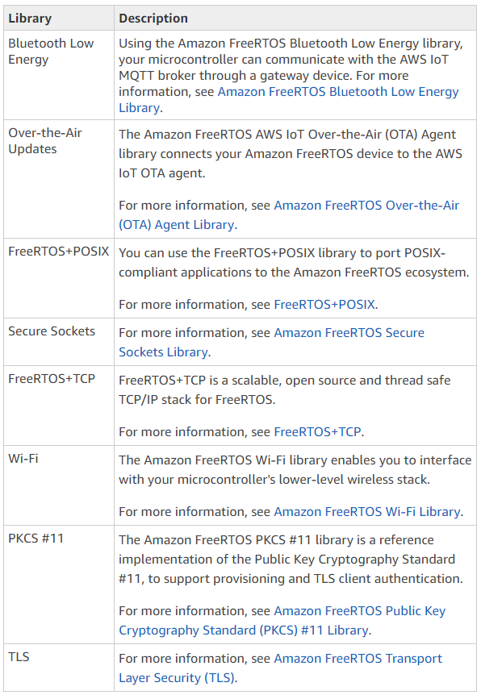
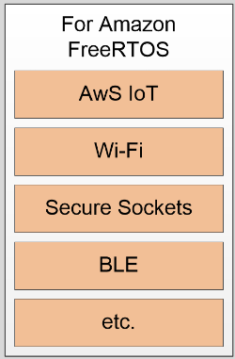
Amazon FreeRTOS libraries
It is a rich ecosystem

Slide 40
Resources
ModusToolbox User Guide
ModusToolbox Software Overview
Running ModusToolbox from the Command Line
Cypress Github Landing Page
Mbed OS Cypress Page
Amazon FreeRTOS Cypress Repo
Managing the Makefile in ModusToolbox

